Slide 1

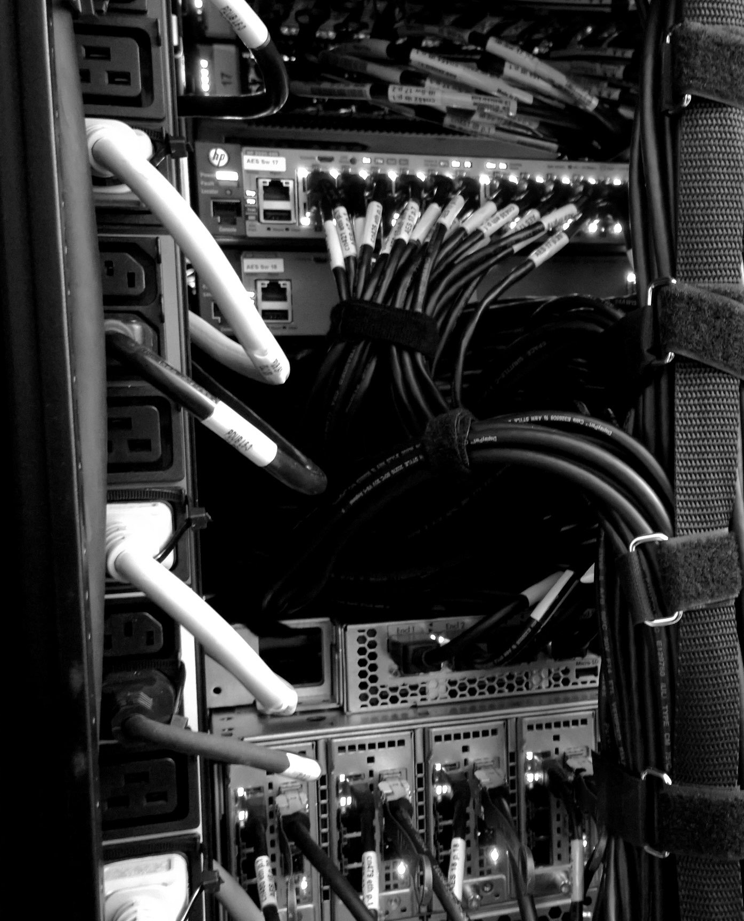
OMPUTEROME 2.0
USERS WORKSHOP
Faculty of Health and Medical Sciences,
University of Copenhagen, February, 2021

Slide 2
WELCOME TO THE C2 USERS WORKSHOP - ANDERS

Slide 3
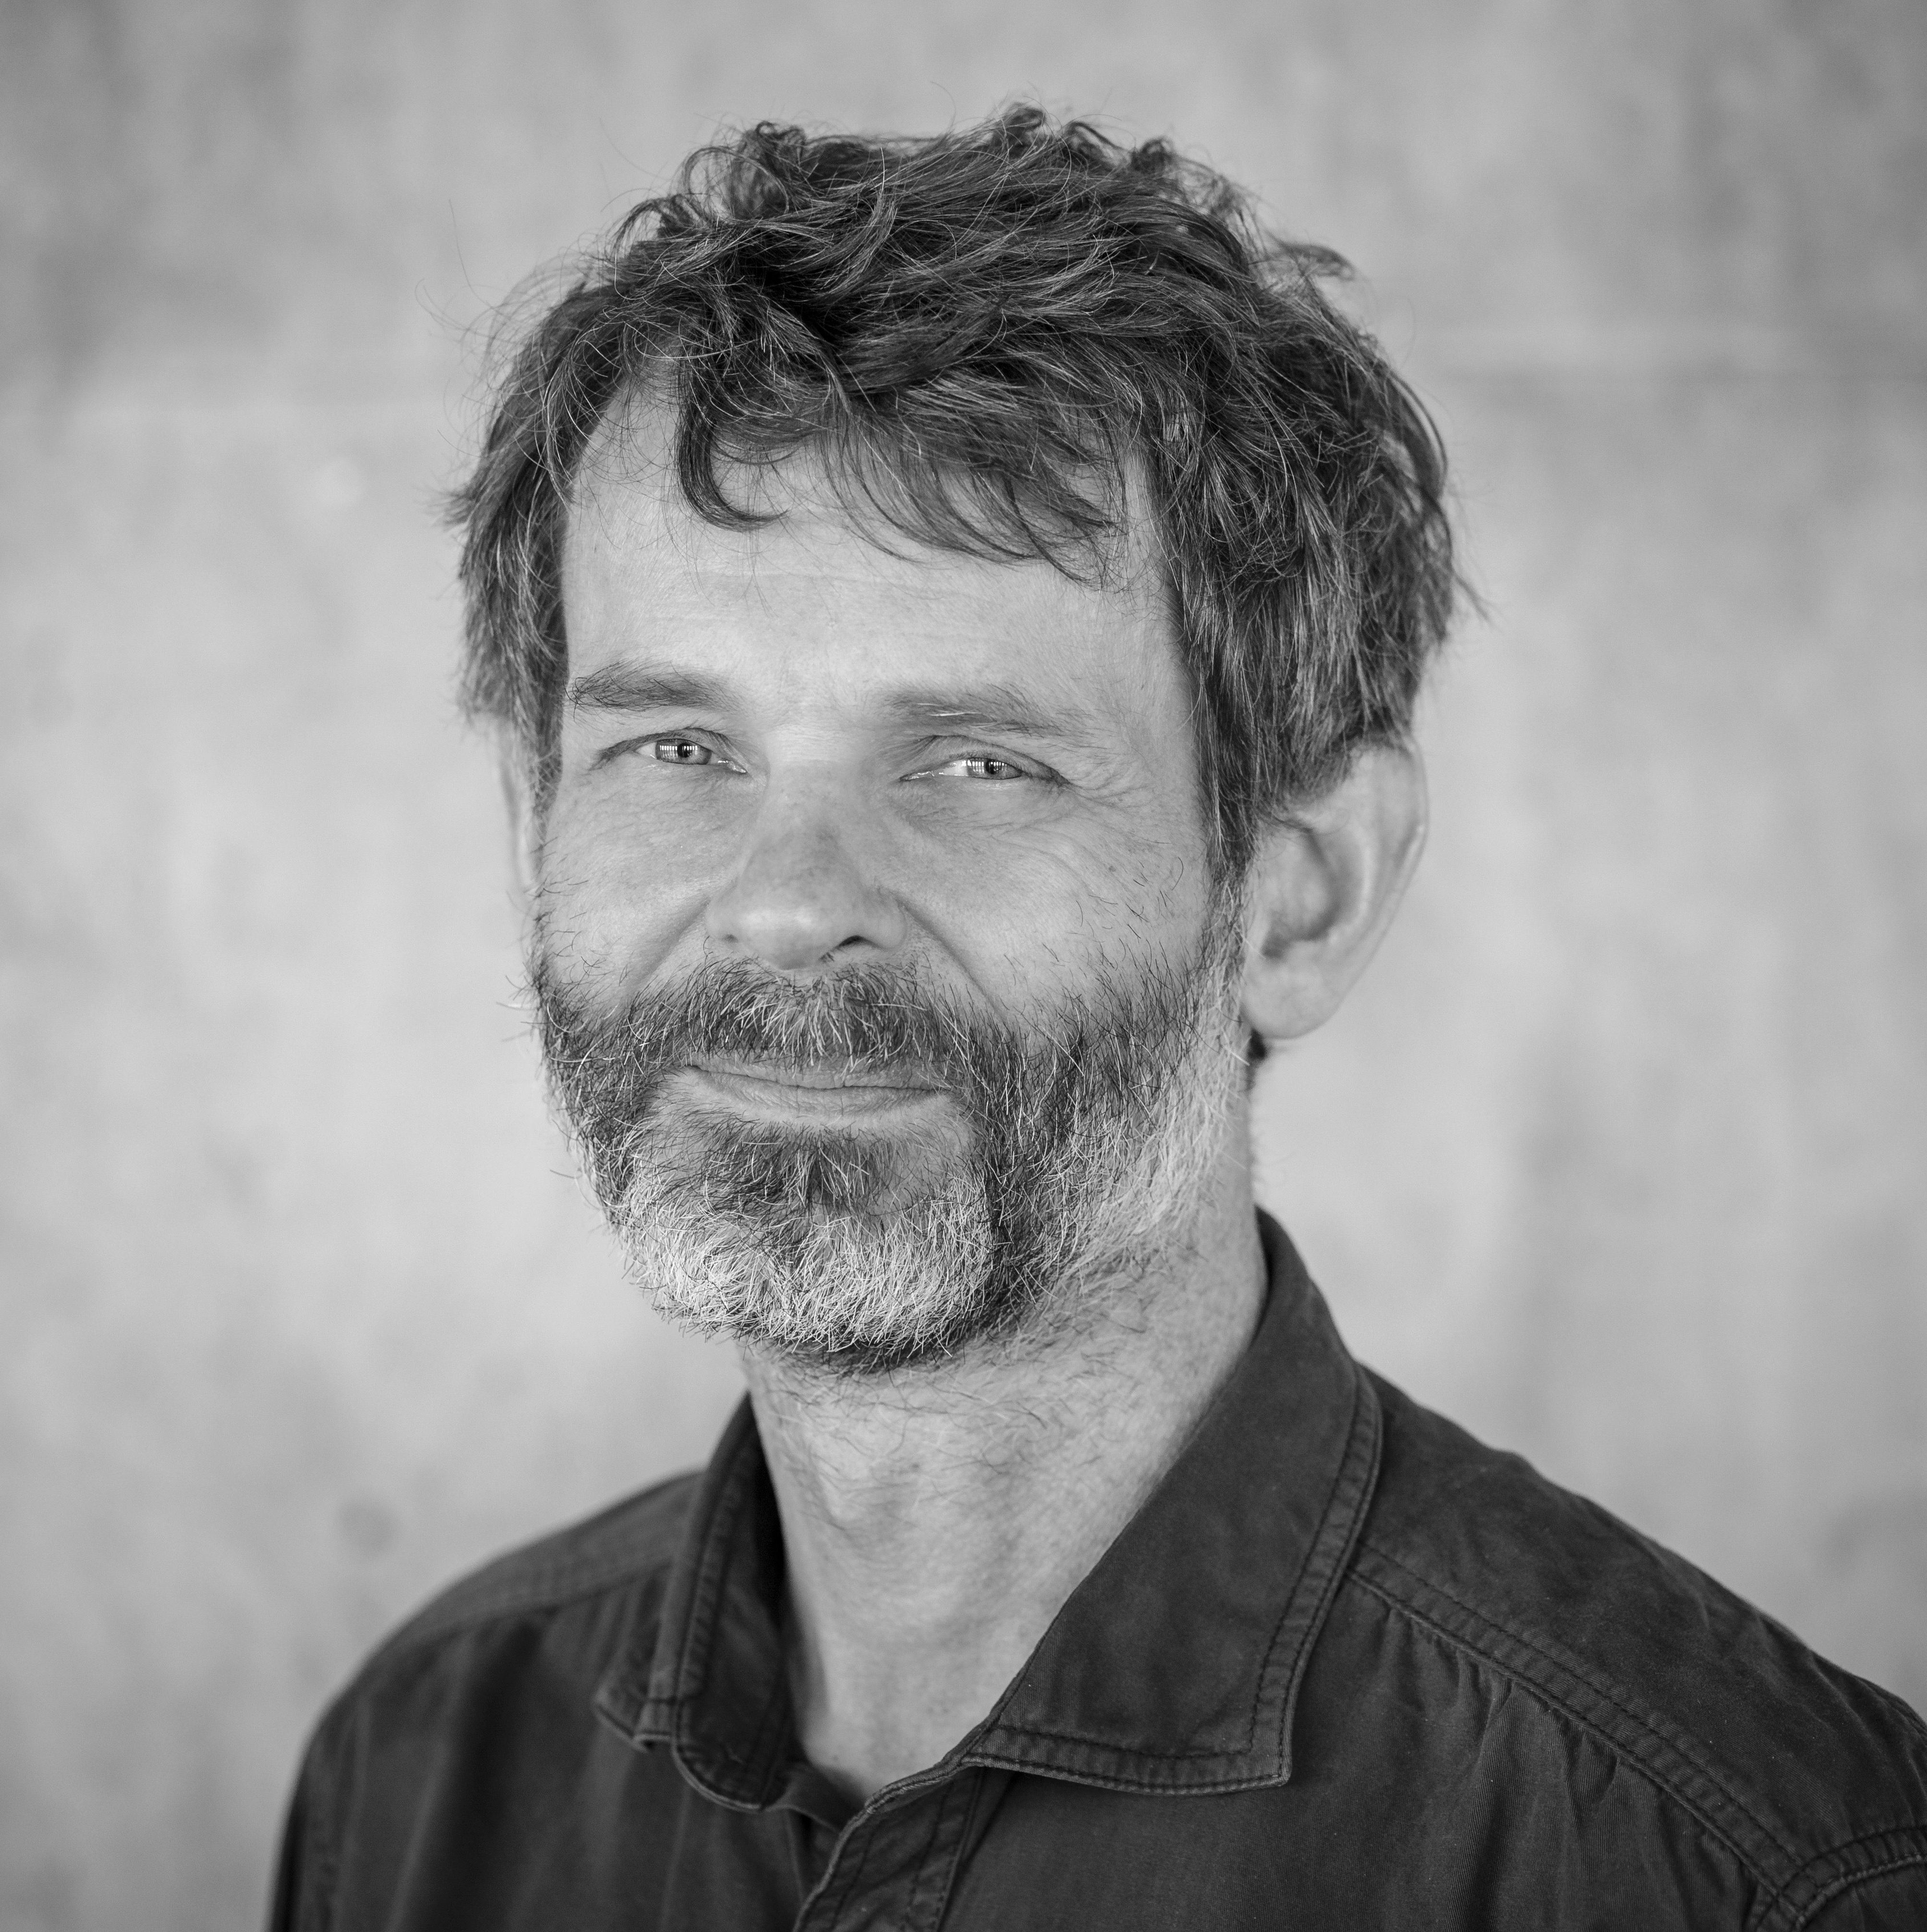
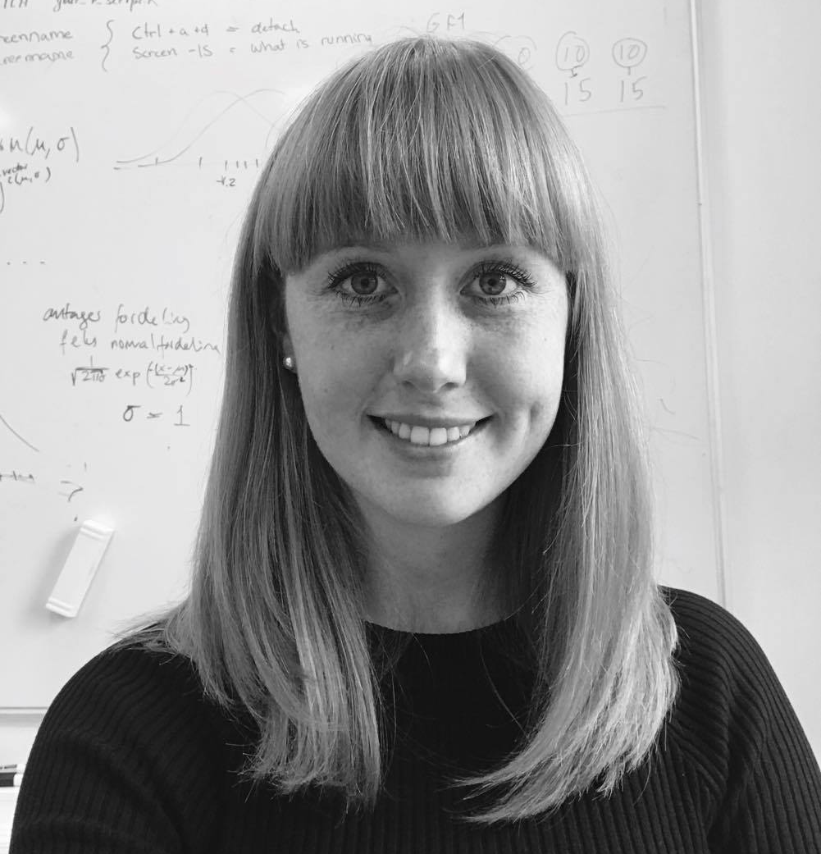
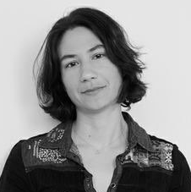

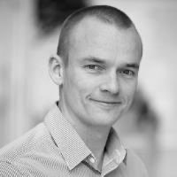
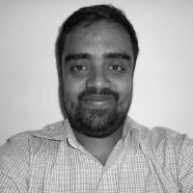
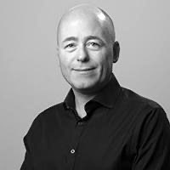
WHO ARE WE
CENTER FOR HEALTH DATA SCIENCE:
Anders Krogh, Professor, Head of Center
Thilde Terkelsen, Data Scientist
DANSTEM:
Magali Michaut, Research Consultant
ANDERS KROGH
THILDE TERKELSEN
MAGALI MICHAUT
GLOBE INSTITUTE:
Bent Petersen, Associate Professor
Shyam Gopalakrishnan, Associate Professor
KU IT:
Allan Have Sørensen, Head of Section
BENT PETERSEN
SHYAM GOPALAKRISHNAN
ALLAN HAVE

Slide 4
PART1
INTRODU TION

Slide 5
INTRODUCTION TO C2 - BENT

Slide 6
PART 2
THE BASI S

Slide 7
BEFORE LOG IN TO COMPUTEROME 2.0
GETTING STARTED:
https://www.computerome.dk/display/C2W/Getting+Started+-+new+users#GettingStarted-newusers-SSHlogintoComputerome2.0
ACCOUNT
ENTRUST APP
PUTTY OR MOBAXTERM
(WINDOWS ONLY)
THINLINK CLIENT
Request a Computerome 2.0 account (group) in KU-IT self-service. Standard or Sandbox.
Two-factor authentication. Install the Entrust app on your phone or alternatively use the SMS option.
Windows users should have an ssh client. MobaXterm users have to configure their ssh settings - see link.
IF you would like a virtual environment, install the ThinLink Client - make sure to keep it updated.

Slide 8
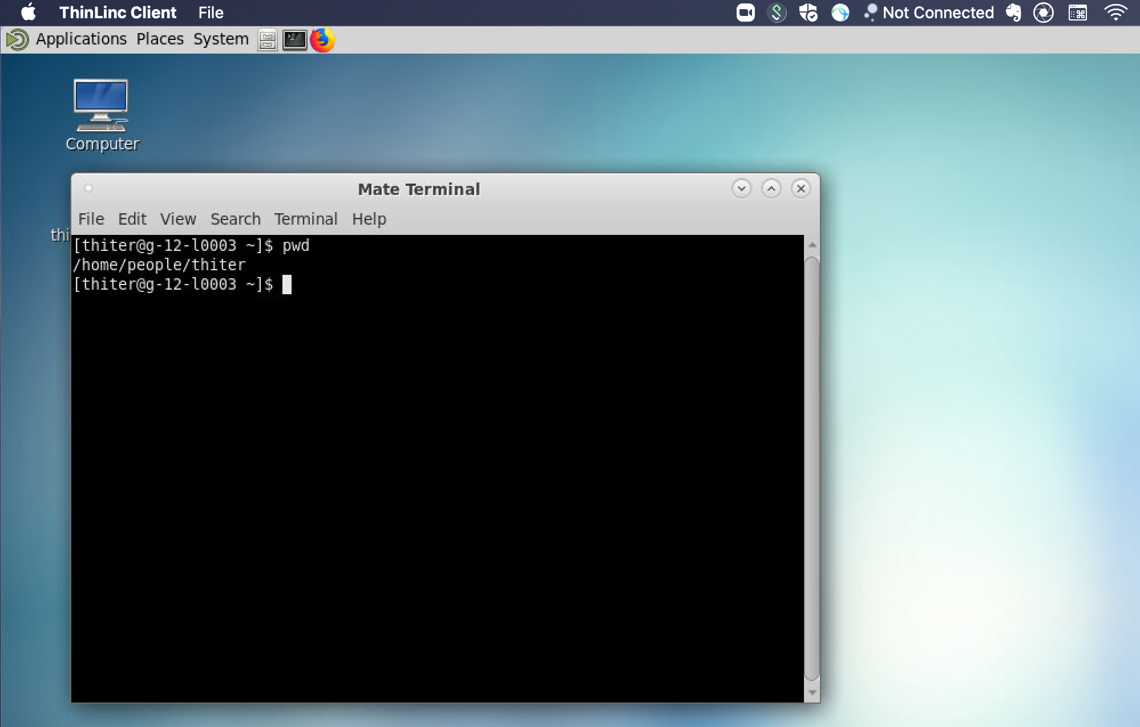
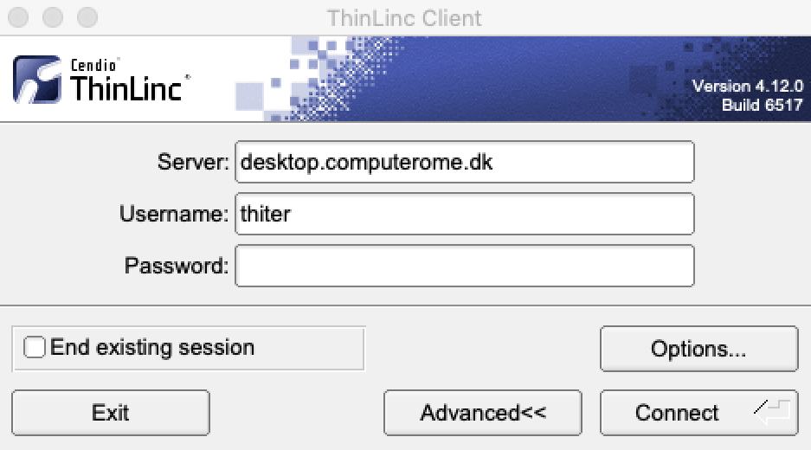
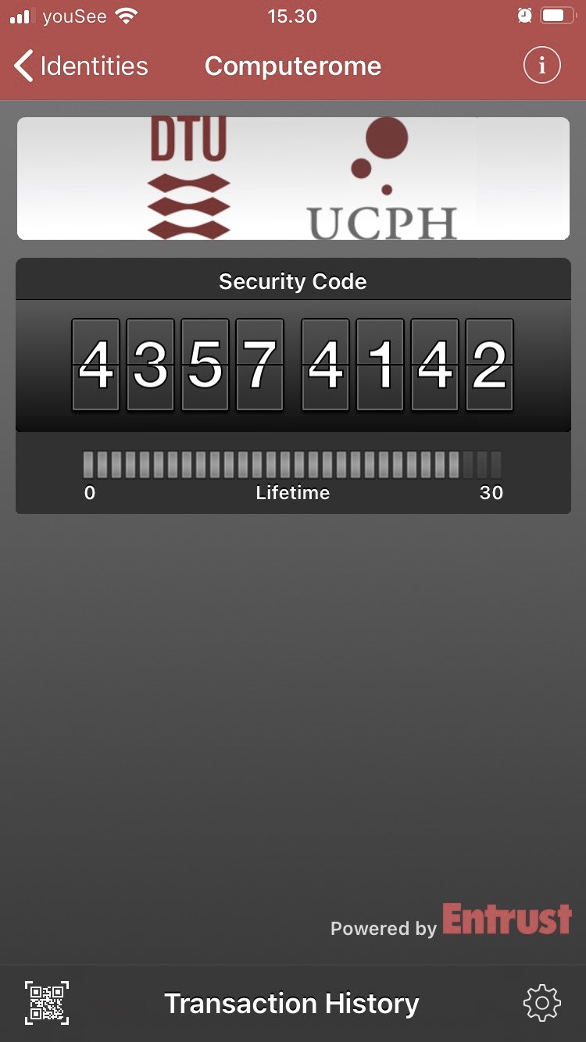
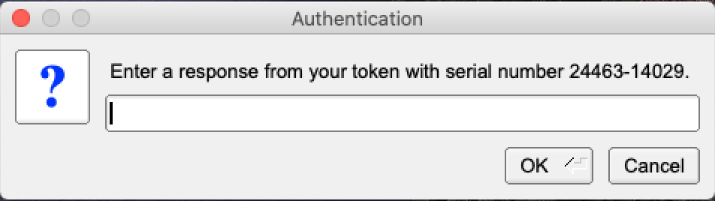
LOG IN TO COMPUTEROME 2.0 2.0
LOG IN WITH THINLINK
Download and install the ThinLink Client
Open and enter your Username + Password
It make take a couple of minutes to connect
Enter the token from the Entrust App (or Confirm)
Open a terminal or click your way around
>
LOG IN WITH SSH
Open a terminal
ssh username@ssh.computerome.dk
Enter your password
Enter the token from the Entrust App (or Confirm)

Slide 9
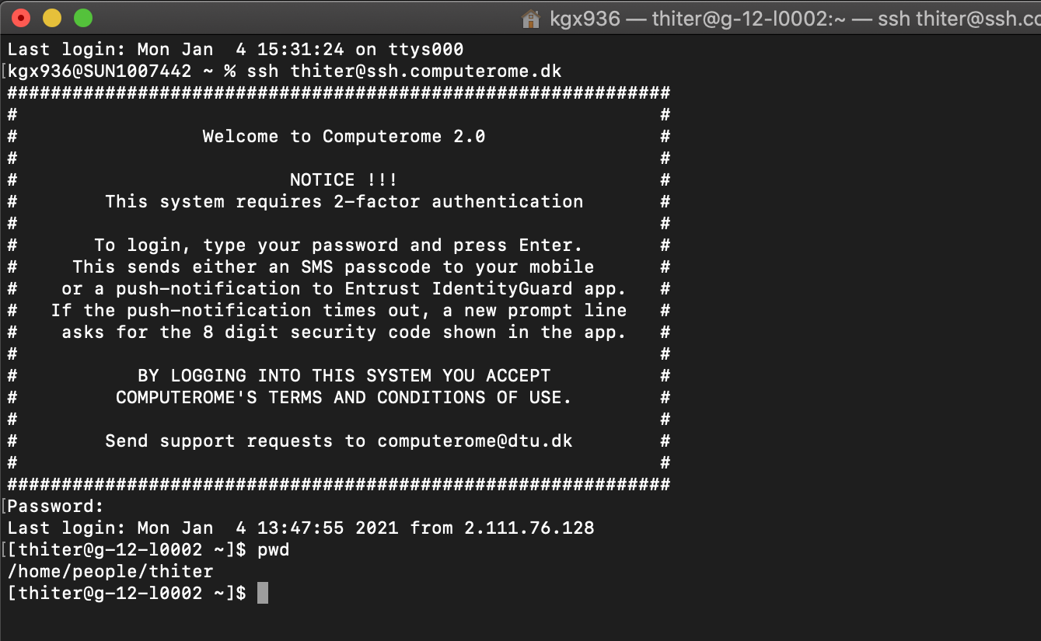
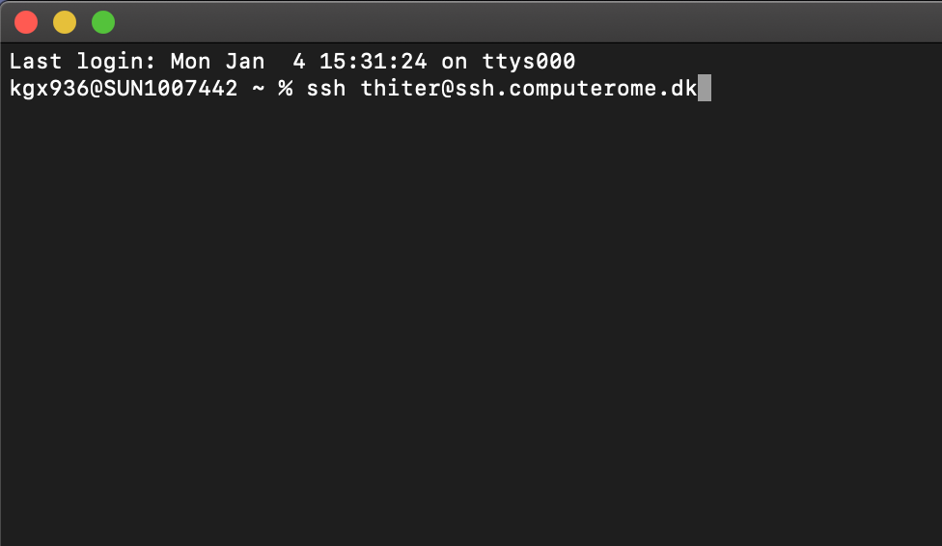
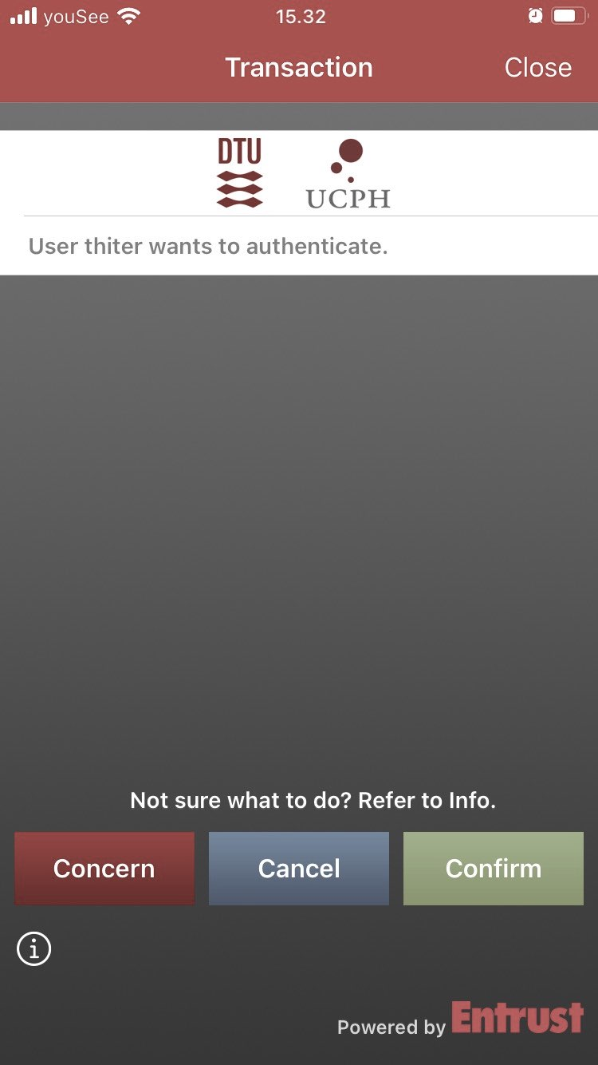
LOG IN TO COMPUTEROME 2.0 2.0
LOG IN WITH THINLINK
Download and install the ThinLink Client
Open and enter your Username + Password
It make take a couple of minutes to connect
Enter the token from the Entrust App (or Confirm)
Open a terminal or click your way around
>
LOG IN WITH SSH
Open a terminal
ssh username@ssh.computerome.dk
Enter your password
Enter the token from the Entrust App (or Confirm)

Slide 10
C2 SANDBOX STRUCTURE
HOME
DATABASES
PEOPLE
PROJECTS
DB X
DB Y
DB Z
(…)
(…)
PRO 1
PRO 2
PRO 3
(…)
(…)
(…)
(…)
LOG IN
(…)
APPS
DATA
PEOPLE
WORK HERE

Slide 11
C2 SANDBOX STRUCTURE
1
/home/people/username
2
/home/databases
HOME
HOME
Your private directory.
This space is meant for configuration files.
Do NOT store data here (max 10G)
Do NOT run jobs from here.
Shared database resource
Databases include:
PEOPLE
DATABASES
Human genomes
Blast
TCGA / GTEx
dbSNP
ClinVar / COSMIC
…
DB X
DB Y
DB Z
(…)
(…)
(…)
LOG IN

Slide 12
C2 SANDBOX STRUCTURE
3
/home/projects/project
HOME
Your project directory.
./apps : project specific applications & modulefiles
./archive: dataproject specific data
./scratch: temporary & re-creatable data N.B will not be backed up!
./review used for peer-review.
PEOPLE
PRO NAME
YOUR PROJECT
APPS
ARCHIVE
DATA
PEOPLE
REVIEW
SCRATCH
APPS
RAW
GENERATED
WORK HERE
MODULEFILES

Slide 13
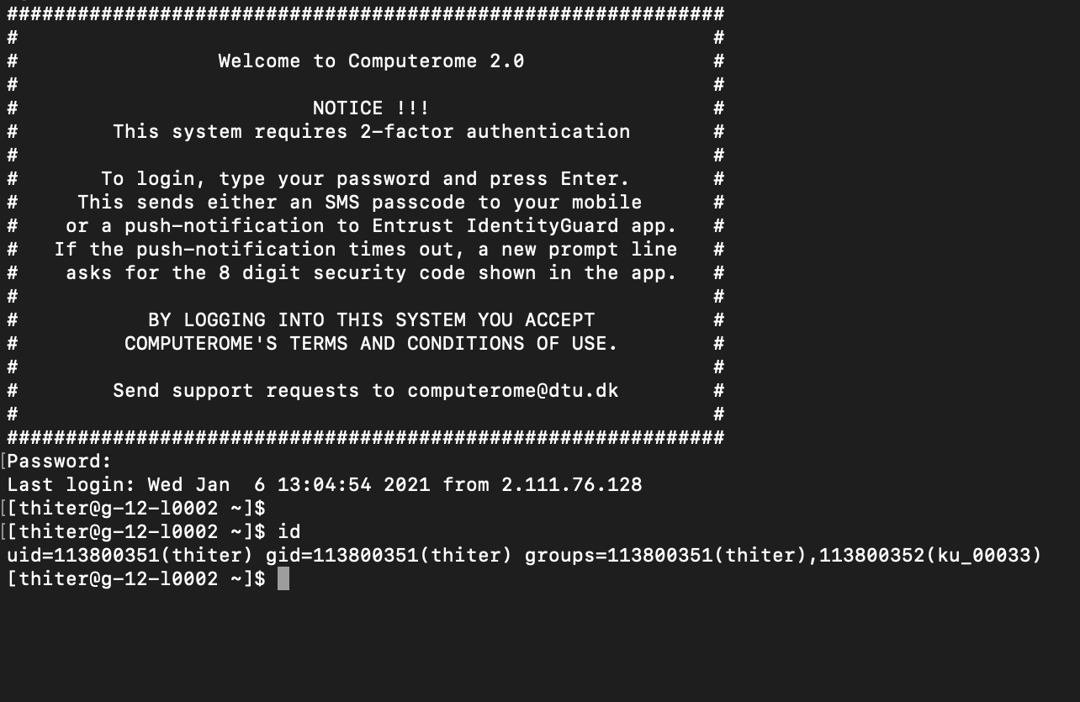
YOUR PROJECT AND GROUP
PROJECT
PROJECT NAME
Type in <id> to get this information
<project> usually refers to the projects funding.
<project_name> is the name given by the C2 team. Almost exclusively the same as <project>.
USERNAME
<username>
Your unique user ID. Can be connected to multiple projects and groups.
GROUP NAME
UNIX
<group_name>
ID assigned by DTU. Refers to the UNIX group, e.g. the projects/users access to resources.
Often the same as <project_name>.

Slide 14
GOOD TO KNOW
COMPUTEROME 2.0 WIKI - FIND EVERYTHING HERE
https://www.computerome.dk/
VIDEO TUTORIALS - HELPFUL TO WINDOWS USERS
https://www.computerome.dk/display/C2W/Video+Tutorials
BRUSH UP ON YOUR UNIX SKILLS
https://www.computerome.dk/display/C2W/Getting+Started+-+new+users?preview=/42205237/42205239/Hackinars_in_Computerome-wiki.pdf
CHECK YOUR USAGE ON C2
module load tools usage_script/2.0
usage -u username
CHECK YOUR USAGE ON C2
GETTING HELP
Write to computerome@dtu.dk
Subject description
System, e.g. Computerome main, sandbox, or <named> cloud system
Login issues, ThinLinc vs SSH login, username & error message(s)
Command line(s) used
Describe the problem including error messages

Slide 15
PART3
WORKING ON OMPUTEROME 2.0

Slide 16
WORKING ON COMPUTEROME 2.0 - MAGALI

Slide 17
PART4
A BRIEF TECHIN AL INTERMEZZO

Slide 18
A BREIF TECHINCAL INTERMEZZO - ALLAN

Slide 19
PART5
2 MODULES & QUEING SYSTEM

Slide 20
MODULES, QUEING SYSTEM & SCRIPTS - SHYAM

Slide 21
PART6
OPTIMIZATION OF TIME & OST

Slide 22
OPTIMIZATION OF TIME AND COST ON C2 - SHYAM

